Slide 1

AutoTemp Cleaner Using Python
Pranay Bhere – 24206004
Prajwal Dhanawade – 24206007
Om Brahmavale – 24206008
Gaurav Kshirsagar – 24206009
Project Guide
Ms. Suruchi Ruiwale

Slide 2
Outline
Introduction
Literature Survey of the Existing Systems
Limitations of the Existing Systems
Problem Statement
System Design
Technologies and Methodologies
Implementation Screenshots(Partial )
Conclusion
References

Slide 3
Introduction
Project Overview: Auto Temp Cleaner is designed to address the problem of accumulating temporary files, caches, and redundant data on computers.
User-Friendly Solution: The tool provides an efficient and easy method for users to clear unnecessary temporary files, aiming to free up disk space and improve system performance.
Target Audience: The project caters to both individual users and organizations, promoting a clutter-free computing environment.
Flexible Management Options: Users are offered three distinct options for managing their temporary files, allowing them to choose the specific duration for file removal based on their preferences and time constraints.

Slide 4
Literature Survey of the Existing System
Several solution for cleaning temporary files:
Built-in:. Windows Disk Cleanup.
Third-Party Apps: CCleaner.
Drawbacks Of these solutions:
I) Manual Intervention Required
II) System Resource Consumption
III) Privacy Concerns.
After conducting user survey, these are the most commonly asked features
I) Automation II) Simplicity III) Privacy IV) Minimal System Impact.

Slide 5
Literature Survey of the Existing System
Features Implemented in our Application:
Automation
Customization
Minimal Resource Usage
User-Friendly Interface
Storage usage graph
Auto-startup

Slide 6
Problem statement
Problem Identification: The increase in temporary files, cached data, and unnecessary documents overwhelms computer systems, consuming critical disk space.
Performance Impact: Accumulation of these files leads to slow boot times, lagging applications, and decreased system responsiveness.
User Challenges: Users experience frustration due to the negative effects of clutter on their systems.
Project Objective: The project aims to provide effective solutions to mitigate the impact of digital clutter, ensuring a smoother and optimized computing experience.

Slide 7
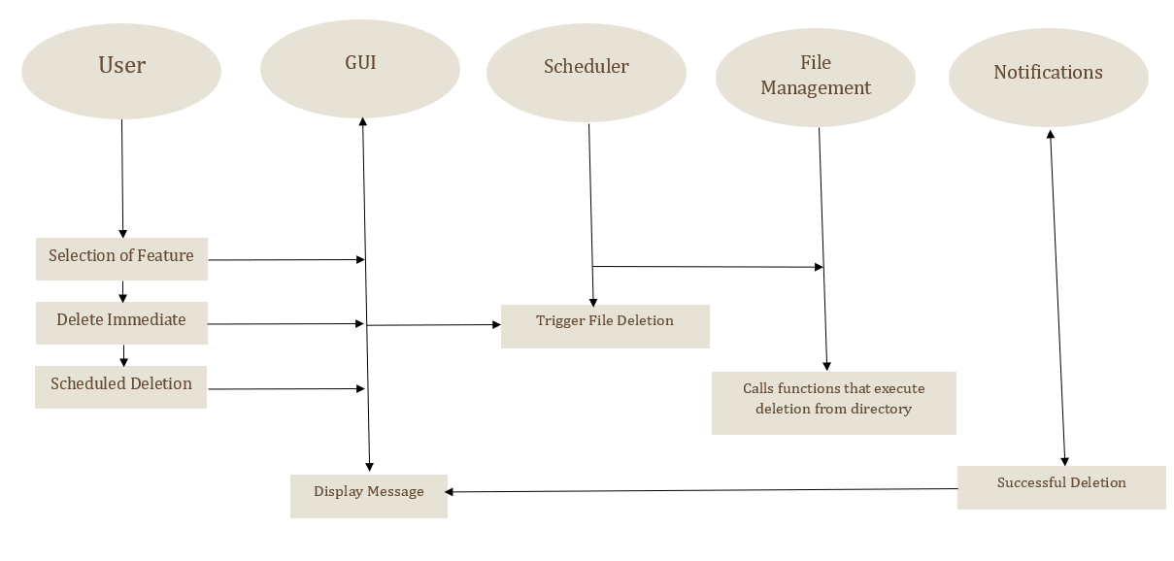
System Design

Slide 8
System Design
Architectural Overview:
The system follows a Modular Architecture where each component performs a specific function. This design ensures that the application is flexible, maintainable, and scalable.
GUI Module: Provides an interface for users to interact with the application (create schedules, manually delete files, etc.)
File Management Module: Handles all file and directory operations (deleting files, directories, and subdirectories).Handles all file and directory operations (deleting files, directories, and subdirectories).
Scheduling Module: Responsible for managing and executing automated tasks like scheduled deletion at specified intervals.

Slide 9
Technologies and Methodologies
The combination of Python, its libraries, and GUI frameworks ensures an efficient, scalable, and user-friendly solution.
Technologies:
Python: The core programming language is Python, chosen for its simplicity, readability, and rich standard libraries like os and shutil for file management. Python is also cross-platform, allowing easy future expansion beyond Windows.
PySide6 (Qt for Python): The GUI is built using PySide6, a Qt binding for Python. It offers a consistent cross-platform interface, providing a wide variety of widgets to create an intuitive user experience. The signal-slot mechanism allows responsive interactions between the user and backend tasks.

Slide 10
Technologies and Methodologies
File Management: Python’s os and shutil libraries handle file and directory operations. They provide methods for deleting files and traversing directories, ensuring efficient and platform-independent file management.
Scheduling: The schedule library is used to automate file deletions daily, weekly, or monthly. Its human-readable syntax and easy integration with threading make it ideal for running background tasks without blocking the UI.
Threading (Python's threading Library): The threading module ensures concurrency by running the scheduler in a background thread. This prevents the main application from freezing and maintains responsiveness during scheduled tasks.

Slide 11
Technologies and Methodologies
Methodologies:
Modular Design: The program is divided into modules (e.g., GUI, scheduling), making it easier to maintain and extend.
Event-Driven Programming: The UI responds in real time to user actions, enhancing interactivity.
Multi-Threading: Scheduled tasks run concurrently without affecting the main interface.
User-Centric Design: The simple, accessible interface caters to both technical and non-technical users.

Slide 12
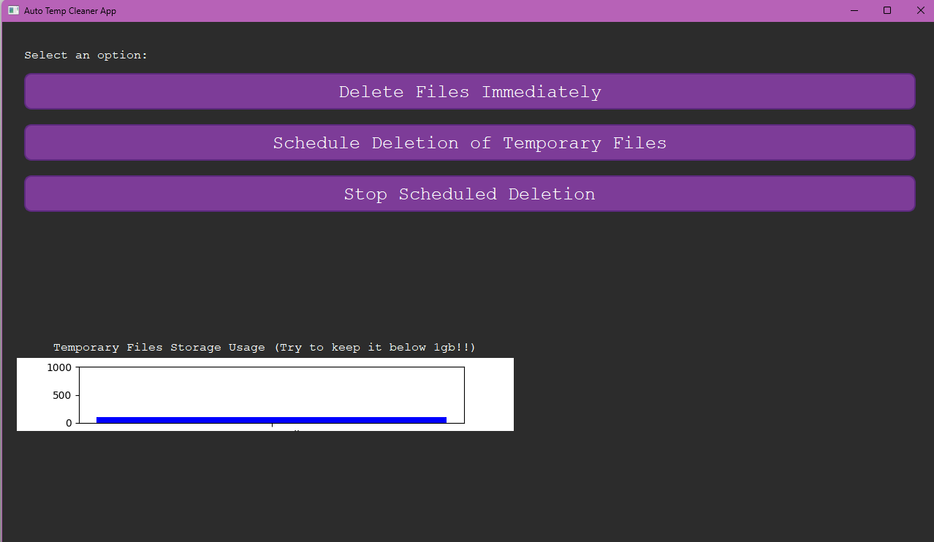
Implementation
Home Page

Slide 13
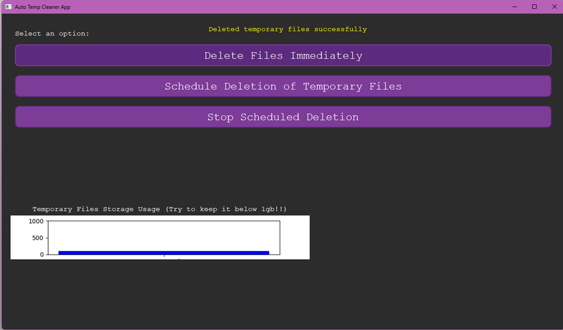
Implementation
Deleting Immediately

Slide 14
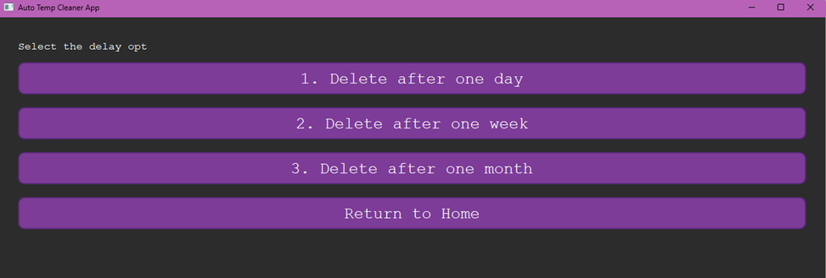
Implementation
Scheduling Deletion

Slide 15
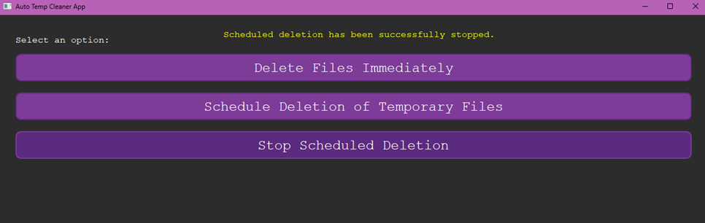
Implementation
Stopping the Scheduled Deletion

Slide 16
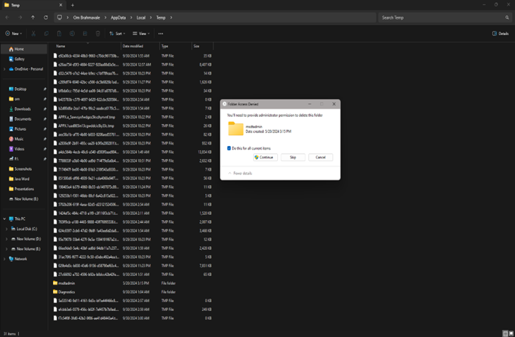
Implementation
Exceptions for Admin/System Files

Slide 17
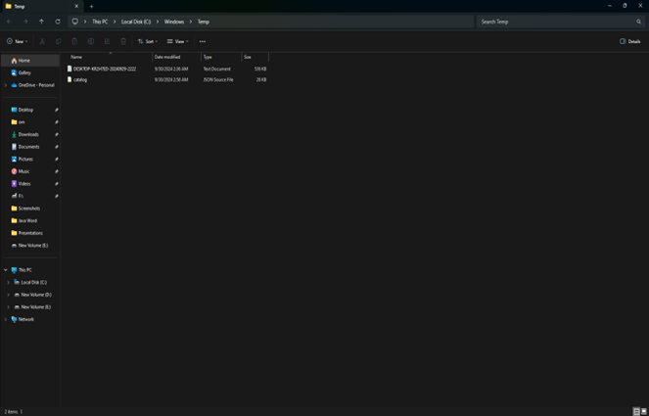
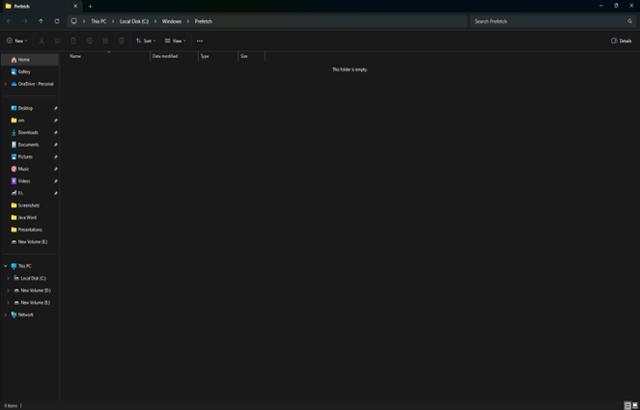
Implementation
Deleted Temp Folders

Slide 18
Conclusion
Addressing Digital Demand: The application effectively addresses the growing concern of accumulating temporary and cached data in the digital landscape.
Impact on Performance: The accumulation of such data adversely affects storage capacity and overall system performance.
Low Consumption of CPU and Privacy : It almost takes no CPU resources to run since the GUI is sleek and simple and there are no AD’s or any other data collecting modules so it keeps the user data safe.
Storage Reclamation: It empowers users to reclaim valuable storage space, leading to noticeable improvements in system speed and responsiveness.
Drawbacks: No backups of files that are deleted, the application’s GUI is not the best, no history.

Slide 19
References
Pooja Bhardwaj, Chahil Choudhury, Priya Batra A Comparative Study of Popular Libraries and their Application IEEE Xplore, 2023. https://ieeexplore.ieee.org/document/10390032
Andrew Miller, Nicholas Kobylski, Elias Qamar, Jimmy Xiao, Nicholas Veal, Richard Kenney, Nicholas Wysocki, Mohammed Mahmoud. Automating File Operations via Python IEEE Xplore, 2022, https://ieeexplore.ieee.org/document/10216551
Viji Rajendran V, Denil C Verghese, Mohammed Arshu P T, Subin T G A Python Library for Automated Machine Learning IEE Xplore, 2021, https://ieeexplore.ieee.org/document/9544859

Slide 20
Thank You...!!

